Slide 1
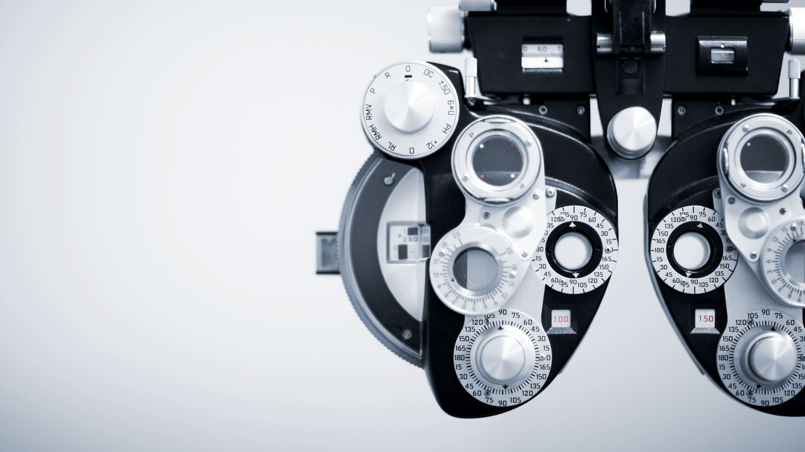
Machine Learning-Iris Classification
With Nvidia Jetson Nano Developer Kit

Slide 2
Data Definition Machine Learning - Iris Classification
The Iris dataset is a renowned benchmark in the realm of machine learning, serving as a foundational example for classification tasks.
It comprises 150 samples of iris flowers, each characterized by four features: sepal length, sepal width, petal length, and petal width.
The objective is to categorize these iris flowers into three distinct species: Setosa, Versicolor, or Virginica.

Slide 3


Code on Nvidia Data Loading
Importing the necessary libraries;
Loading data

Slide 4



Machine Learning Part
Importing the necessary libraries;
Train-test spliting
Initialize the model
Train the model

Slide 5


Machine Learning Part Cont.
Make predictions on the test set
Calculate the accuracy of the model

Slide 6
Code Description
Importing Libraries: This code imports necessary libraries. load_iris is used to load the Iris dataset, and pandas is imported as pd for data manipulation.
Loading the Dataset:
The Iris dataset is loaded using load_iris().
The features are stored in a DataFrame df where columns are labeled with feature names.
The target variable (species) is added to the DataFrame as a categorical variable.
Splitting the Dataset:
The dataset is split into features (X) and the target variable (y).
train_test_split is used to split the dataset into training and testing sets. Here, 70% of the data is used for training (X_train and y_train) and 30% for testing (X_test and y_test).
random_state is set to 42 to ensure reproducibility of results.

Slide 7
Code Description Cont.
Initializing the Model: This code initializes a Decision Tree classifier model.
Training the Model: The model is trained on the training data using the fit method.
Making Predictions: Predictions are made on the test set using the predict method.
Evaluating Model Accuracy:
The accuracy of the model is calculated by comparing the predicted labels (y_pred) with the actual labels (y_test).
The accuracy score is printed to evaluate the performance of the model.

Slide 8
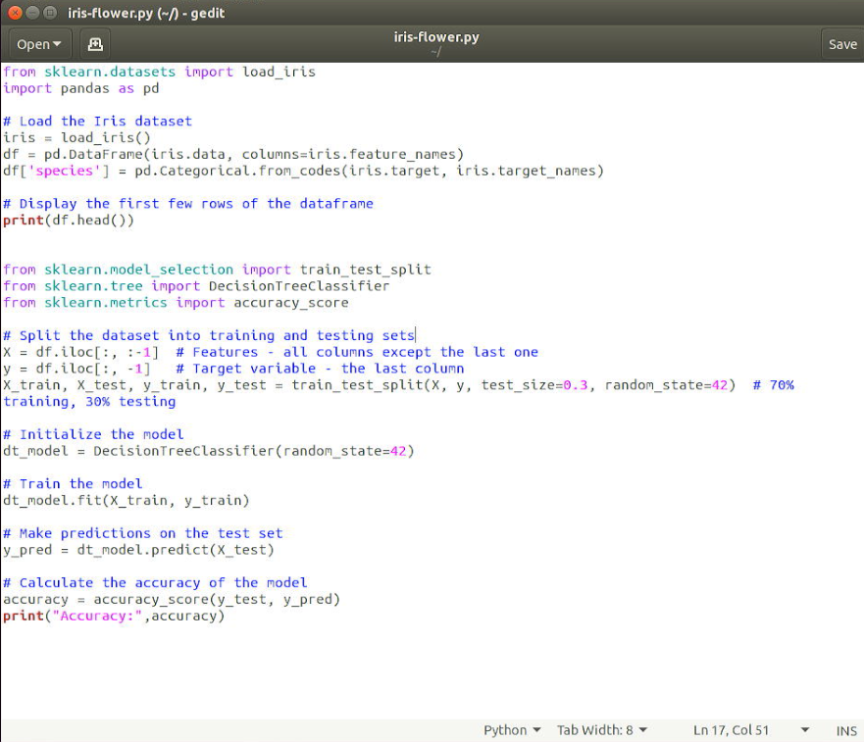
Code On Nvidia Jetson Nano

Slide 9
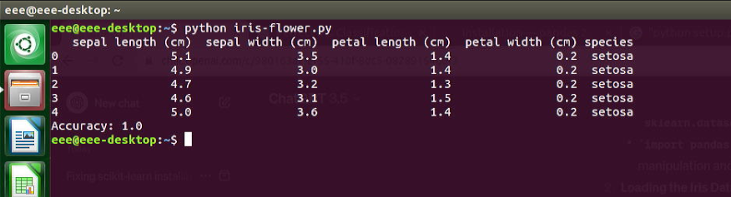
Output of the code

Slide 10
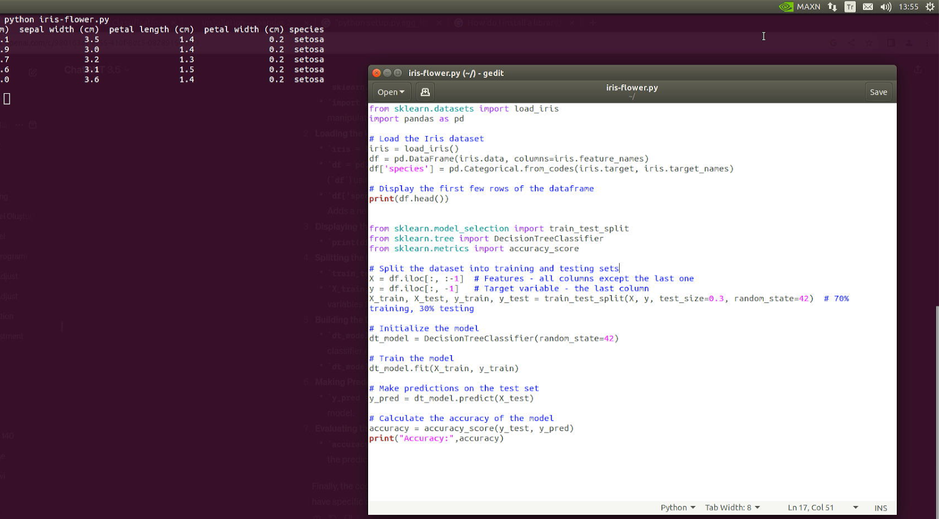

Slide 11
